Slide 1

PHONE BOOK MANAGEMENT
Team members
1.SAKETHRAM MANCHALA.
2.SAI KIRAN MADALA.

Slide 2
DIVISION OF PROJECT TO MAKE IT EASIER
This project is divided into six parts:
1.how to create a contact in your mobile
2.how to save a contact in your mobile.
3.how to modify a contact in your mobile .
4.how to find a contact in your mobile.
5.how to delete a contact from your mobile.
6.how to exit from the contacts

Slide 3
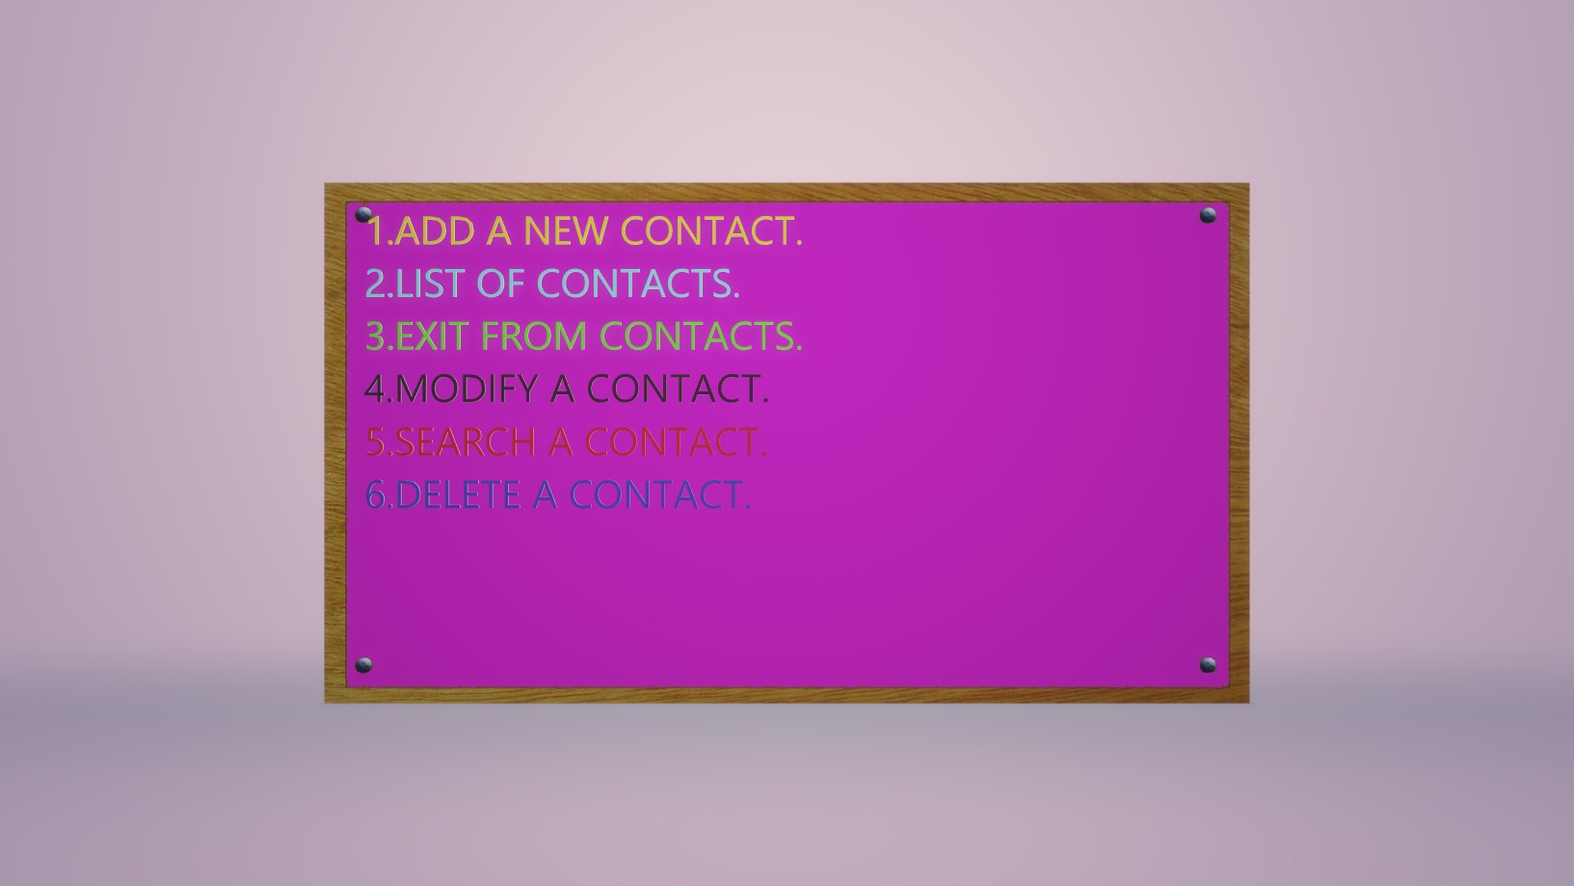
ABSTRACT
.
Our project “phone book management” is about how to manage the contacts in our mobile and we have divided this project into six buttons those are
1.add new contact.
2.modifying a contact.
3.list of a contact.
4.exit from contacts.
5.search a contact.
6.delete a contact.
And we have made it as much as
easier we can do so that a person
can easily understand working
and it becomes easy for person to
operate.

Slide 4
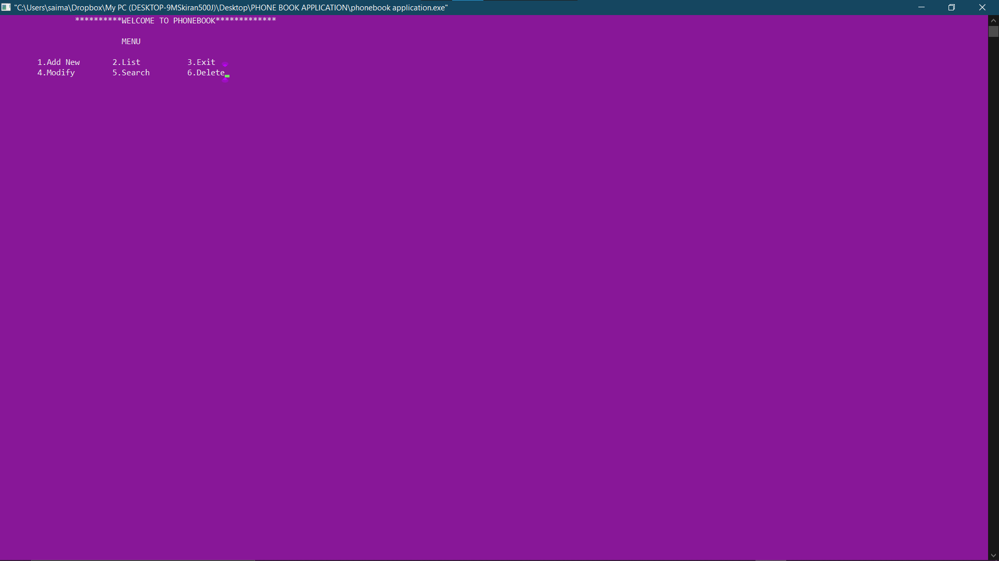
INTERFACE AFTER RUNNING THE CODE

Slide 5
Introduction
>Introduction:
we can use this project called PHONE BOOK MANAGEMENT to replace our hard phone book or even use it as an office wide phone directory this will help user to easily search and manage contacts using this system.
This system is developed using the general need required by the user while using the phone directory book. In order to keep updated the user will have authority to add and delete as well as modify the existing record within the phone book directory.
To provide the search results within short interval of time optimized search algorithm cade have used that willable to provide the results within seconds.
The project is basically about phonebook management the use of this project is to manage the contacts of the people which includes their phone number, address, email. This entire program runs majorly using switch case which allows user to choose his requirement whether he wants to enter a new contact, edit an existing contact, deleting an existing contact etc.. With the help of this project people can store any number of contacts they require and search for the contact which is saved before in the memory.

Slide 6
SOFTWARE REQUIREMENTS
WE ARE USING CODEBLOCKS SOFTWARE TO BUILD OUR PROJECTS AND TO GET REQUIRED OUTPUT WE WANT

Slide 7
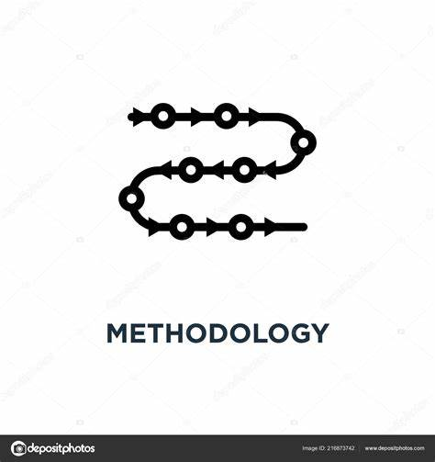
methodology
To satisfy the user's requirement we will provide them different options to manage contacts. switch case in the code helps us to provide different options for user's usage.
We will ask the user to provide input based on their requirement and we will ask them to provide the details displayed on the screen.
The code will process the data which was received as input by user and saved in the memory of device.

Slide 8
Result:
WE MADE THE PROJECT IN SUCH A WAY THAT THE RESULTS WILL BE GIVEN IN 6 BUTTONS
1.ADD WE USE THIS BUTTON TO ADD A NEW PERSON TO OUR CONTACT.
2.SEARCH WE USE THIS BUTTON TO SEARCH OR FIND A CONTACT IN OUR MOBILE.
3.LIST WE USE THIS BUTTON FOR LISTING OF CONTACTS.
4.MODIFY WE USE THIS BUTTON FOR MODIFYING A CONTACT.
5.DELETE WE USE THIS BUTTON FOR DELETING A CONTACT.
6.EXIT WE USE THIS BUTTON FOR EXITING OF A CONTACT.

Slide 9
DISCUSSION
NOTE: THE BOTTONS IS BASED ON THE INTERFACE WE HAVE PASTED ON THE SNIPPET.
In this discussion we will explain the project more clearly
1.IF YOU PRESS BUTTON 1 THAT MEANS YOU WANT TO ADD A NEW CONTACT TO YOUR MOBILE IN YOUR CONTACT LIST THEN THEN YOU HAVE TO GIVE THE INPUT DETAILS OF THE CONTACT WHICH OR WHOM YOU WANT TO ADD .THE DETAILS YOU HAVE TO GIVE ARE :NAME OF THE PERSON,MOBILE NUMBER OF THE PERSON,THE ADDRESS OF THE PERSON,HI FATHER NAME,MOTHER NAME,GENDER OF THE PERSON,E MAIL OF THE PERSON.
2.IF YOU PRESS 2 THAT MEANS YOU WANT TO LIST OUT THE CONTACTS THE INPUTS WILL BE THE NAME OF THE PERSON.
3.IF YOU PRESS THE BUTTON 3 THAT MEANS YOU WANT TO GET EXITTED FROM THE CONTACTS.
4.IF YOU PRESS THE BUTTON 4 THAT MEANS YOU WANT TO MODIFY A CONTACT FOR THAT YOU
HAVE TO GIVE THE INPUT DETAILS LIKE NAME OF THE CONTACT WHOM YOU WANT TO MODIFY.
5.IF YOU PRESS THE BUTTON 5 THAT MEANS YOU WANT TO SEARCH A CONTACT AND THE INPUT YOU HAVE TO ARE NAME THE PERSON.
6.IF YOU PRESS THE BUTTON 6 THAT MEANS YOU WANT TO DELETE A CONTACT AND THE INPUT
YOU HAVE TO GIVE ARE NAME OF THE PERSON.

Slide 10

CONCLUSION
BY THIS PROJECT WE CAN CONCLUDE THAT THE USAGE OF CONTACTS BECOMES EASIER AND THE MAKING OF CALLS,DELETING,LISTING,SEARCHING,MODIFYING,ADDING A CONTACT BECOMES EASY TO UNDERSTAND FOR THRE USER.

Slide 11
FUTURE PROSPECTS
In future this project is used to improve the strength of contacts in our mobiles and even this project helps to prevent a new app for contacts and this helps to improve the simplicity of contacts app And this projects helps to simplify usage of app and this code helps to print output simply and even we can give the inputs easily and in future the people can easily use the app and can easily call , modify , add , delete , list , search a contact in our mobile.

Slide 12
REFERENCES
References used in the study should be included in standard format, Example:
MENTOR Manipal university Jaipur.
OUR C PROGRAMMING PROFESOR(MANOJ SIR R).
Google.
some library books.

Slide 13
ACKNOWLEDGEMENTS
I thank “Manipal University Jaipur” for encouraging the students to do the real life projects so that students can achieve their dreams easily. By doing this kind of projects the brains of students be encouraged and becomes more active in working and this kind of learning may also leads to the new inventions in the society and I thank “Nitesh Pradhan sir” our mentor for helping us to do this project and giving us suggestions to improve the projects performance and output looking attractive .Sir helped us to improve the attractive ness in getting the output in different back ground colours in this thing I thank our mentor .I think “Manoj Sir ” our programming professor for teaching us the c coding which played a major role in doing this project and the way of his teaching very nice and students can very easily understand the logics behind the code and Can easily write the code and he can easily understand that a student understand the concept or not and even he takes care of each and every student. finally I thank “Manipal University Jaipur” for implementing this kind of learning process

Slide 14

@THANK YOU FOR ALL

